Slide 1


CLOUD COMPUTING & SECURITY (BIS613D)
MODULE 4
Cloud Security and Trust Management
Dr. Srividya R
Assoc. Professor, ISE Dept.

Slide 2
CCS Module-4
Cloud Security and Trust Management:
Cloud Security:
Top concern for cloud users, Risks, Privacy Impact Assessment, Cloud Data Encryption, Security of Database Services, OS security, VM Security, Security Risks Posed by Shared Images and Management OS, XOAR, A Trusted Hypervisor, Mobile Devices and Cloud Security. (Text Book 2)
Cloud Security and Trust Management:
Cloud Security Defense Strategies, Distributed Intrusion/Anomaly Detection, Data and Software Protection Techniques, Reputation-Guided Protection of Data Centers. (Text Book 1)

Slide 3
Cloud Security and Trust Management
Lacking trust between service providers & cloud users has hindered acceptance of cloud computing as a service on demand.
Trust models have been developed to protect mainly e-commerce and online shopping.
But Cloud platforms become worrisome to some users for lack of privacy protection, security assurance, & copyright protection.
To solve trust problems, a new data-protection model is presented here.
In many cases, one can extend the trust models for P2P networks and grid systems to protect clouds and data centers

Slide 4
Cloud Security Defense Strategies
3 basic cloud security enforcements are expected.
Security in data centers demands on-site security year round. Biometric readers, CCTV (close-circuit TV), motion detection, and man traps are often deployed.
Also, network security demands fault-tolerant external firewalls, intrusion detection systems (IDSes), and third-party vulnerability assessment.
Finally, platform security demands SSL and data decryption, strict password policies, and system trust certification.
Figure shows the mapping of cloud models, where special security measures are deployed at various cloud operating levels

Slide 5
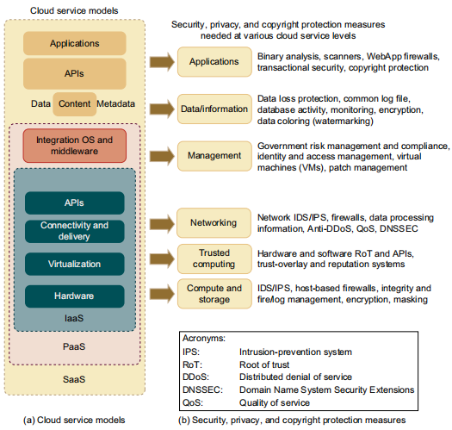
Basic Cloud Security
Servers in cloud can be physical machines or VMs.
The provisioning tool carves out the systems from the cloud to satisfy the requested service.
A security-aware cloud architecture demands security enforcement.
Malware-based attacks such as network worms, viruses, and DDoS attacks exploit system vulnerabilities.
These attacks compromise system functionality or provide unauthorized access to critical information.
Cloud service models on the left (a) and corresponding security measures on the right (b); the IaaS is at the innermost level, PaaS is at the middle level, and SaaS is at the outermost level, including all hardware, software, datasets, and networking resources.

Slide 6
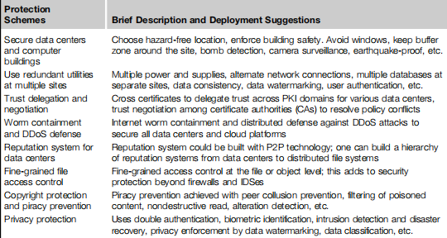
Cloud Defense Methods
Virtualization enhances cloud security.
Security attacks in 1 VM are isolated and contained from affecting other VMs.
Table lists 8 protection schemes to secure public clouds and data centers.
VM failures do not propagate to other VMs.

Slide 7
Privacy and Copyright Protection
Here are several security features desired in a secure cloud:
• Dynamic web services with full support from secure web technologies
• Established trust between users and providers through SLAs and reputation systems
• Effective user identity management and data-access management
• Single sign-on and single sign-off to reduce security enforcement overhead
• Auditing and copyright compliance through proactive enforcement
• Shifting of control of data operations from the client environment to cloud providers
• Protection of sensitive and regulated information in a shared environment

Slide 8
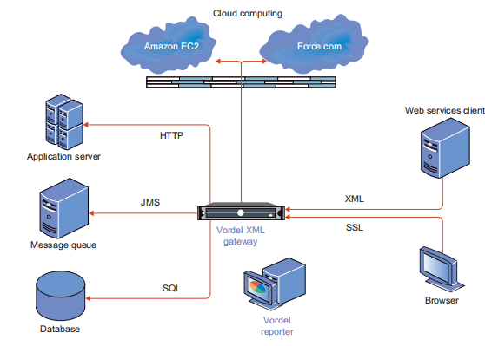
Cloud Security Safeguarded by Gateway and Firewalls
Figure shows a security defense system for a typical private cloud environment.
The gateway is fully secured to protect access to commercial clouds that are open to general public.
Firewall provides an external shield.
The gateway secures with HTTP, JMS, SQL, XML, and SSL security protocols.
Defense scheme is needed to protect user data from server attacks.
User’s private data must not be leaked to other users without permission.
Typical security structure coordinated by secured gateway plus external firewalls to safeguard the access of public or private clouds.

Slide 9
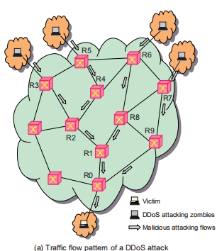
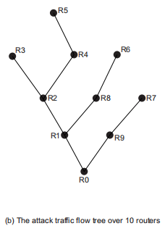
Distributed Defense against DDoS Flooding Attacks
A DDoS defense system must be designed to cover multiple network domains spanned by a given cloud platform.
DDoS attacks come with widespread worms.
Flooding traffic is large enough to crash server, by buffer overflow, disk exhaustion, or connection saturation.
Figure shows a flooding attack pattern.
Here, Hidden attacker launched the attack from many zombies toward a victim server at bottom router R0.
Based on the anomaly pattern detected in covered network domains, the scheme detects a DDoS attack before the victim is overwhelmed.

Slide 10
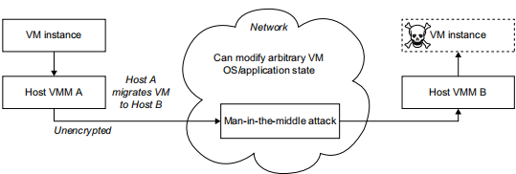
Man-in-the-Middle Attacks
Figure shows VM migration from host machine VMM A to host machine VMM B, via a security vulnerable network.
In a man-in-the-middle attack, attacker can view VM contents, steal sensitive data, or even modify VM-specific contents including OS and application states.
An attacker can launch an active attack to insert a VM-based rootkit into the migrating VM, which can subvert the entire operation without the knowledge of guest OS & embedded application.
A VM migrating from host A to host B through a vulnerable network threatened by a man-in-the-middle attack to modify the VM template and OS state

Slide 11
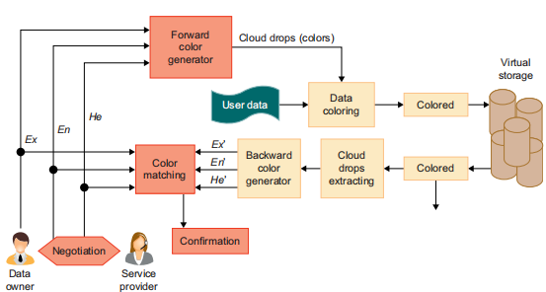
Data Coloring and Cloud Watermarking
With shared data, privacy, security, & copyright information could be compromised.
Users desire to work in a trusted software environment.
As shown in Figure the system generates special colors for each data object.
Data coloring means: labeling each data object by a unique color.
Differently colored data objects are thus distinguishable.
The user identification is also colored to be matched with the data colors.
This color matching process can be applied to implement different trust management events.
Data coloring with cloud watermarking for trust management at various security clearance levels in data centers.

Slide 12
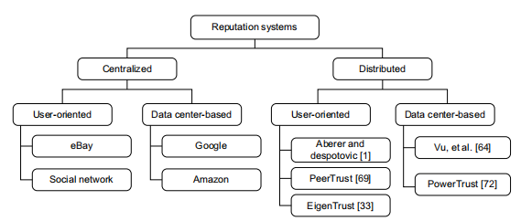
Reputation System Design Options
Public opinion on character (honest behavior or reliability) of an entity could be reputation of a person, an agent, a product, or a service.
To address reputation systems for cloud services, a systematic approach is based on the design criteria and administration of reputation systems.
Reputation systems are classified as centralized or distributed.
Reputation-based trust management and techniques for securing P2P and social networks could be merged to defend data centers and cloud platforms against attacks from the open network.
Design options of reputation systems for social networks and cloud platforms

Slide 13
Trust Overlay Networks
Trust overlay could be structured with a distributed hash table (DHT) to achieve fast aggregation of global reputations from a large number of local reputation scores.
At the bottom layer is the trust overlay for distributed trust negotiation and reputation aggregation over multiple resource sites.
This layer handles user/server authentication, access authorization, trust delegation, & data integrity control.
At the top layer is an overlay for fast virus/worm signature generation & dissemination & for piracy detection.
This overlay facilitates worm containment & IDSes against viruses, worms, & DDoS attacks.
The security-aware cloud architecture is specially tailored to protect virtualized cloud infrastructure.

Slide 14
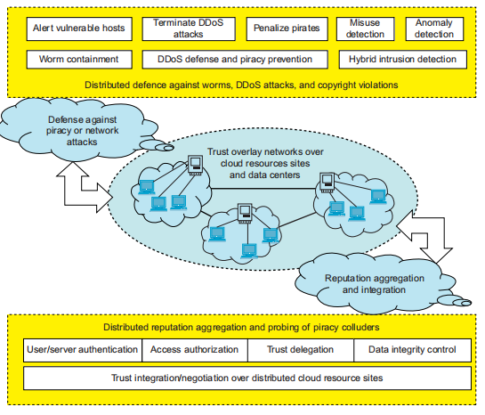
Trust Overlay Networks
Trust of cloud platforms comes from SLAs, & effective enforcement of security policies &deployment of countermeasures to defend against attacks.
By varying security control standards, one can cope with the dynamic variation of cloud operating conditions.
The design is aimed at a trusted cloud environment to ensure high-quality services, including security.
DHT-based trust overlay networks built over cloud resources provisioned from multiple data centers for trust management and distributed security enforcement.

Slide 15
Trust Overlay Networks
In the long run, a new Security as a Service is desired.
This “SaaS” is crucial to the universal acceptance of web-scale cloud computing in personal, business, community, and government applications.
Internet clouds are certainly in line with IT globalization and efficient computer outsourcing.
However, interoperability among different clouds relies on a common operational standard by building a healthy cloud ecosystem.

Slide 16
THANK YOU

